Slide 1
Student Counselling and Wellbeing at the University of Leeds

Slide 2
Student Counselling and Wellbeing supports students at times of difficulty and distress, offering:
Online support through services such as Big White Wall (available to all students)
Self Help Resources
Groups and workshops programme
Single Session Therapeutic Consultations
Mental health and wellbeing support
Brief counselling contracts
Meditation and downloadable MP3s

Slide 3
Notes:
Before talking about Specialist Services, a few words about BWW, which is available to all students:
University of Leeds students going through a tough time can now access free online support with Big White Wall. Whether you’re struggling to sleep, feeling low, stressed or not coping, Big White Wall can help you get support, take control and feel better.
The service provides 24/7 online peer and professional support, with trained counsellors. Big White Wall provides a safe space online to get things off your chest, explore your feelings and learn how to improve and self-manage your mental health and wellbeing.
Big White Wall is totally anonymous, so no one will know you’ve chosen to use it unless you tell them!

Slide 5
We’re a multi-professional team of:
Counsellors
Mental Health Advisors
Wellbeing Practitioners

Slide 6
Principles of all support:
Safe
Confidential
Non judgemental
Respectful of beliefs
Encouraging
All staff professionally qualified
Free

Slide 7
Counsellors
Who are they there for?
Available to all students
Helping students to build an awareness of themselves, perspective and possible choices
Helping students explore issues of concern in a confidential and safe space

Slide 8
What do they provide?
Therapeutic Consultations
A range of counselling interventions through a brief counselling contract
Groups, including meditation and parental loss
Online counselling for students not on campus

Slide 9
Types of difficulties being supported?
Academic worries/ stressors
Depression, anxiety, panic
Eating disorders and self-harm
Confidence, self-esteem
Trauma (past or recent)
Relationship problems (family, peers, partners)
Abuse past or present (sexual, physical, psychological)
Bereavement/loss
Transitional difficulties, homesickness

Slide 10
Wellbeing Practitioners:
Who are they there for?
Students with mild to moderate common mental health problems such as; depression and anxiety disorders.
Students wanting to develop positive problem solving skills and ‘toolkits’ for wellbeing.

Slide 11
What do they provide?
Triage and signposting
Groups and workshops
121 support: brief intervention model, solution focused, skills development, CBT informed.

Slide 12
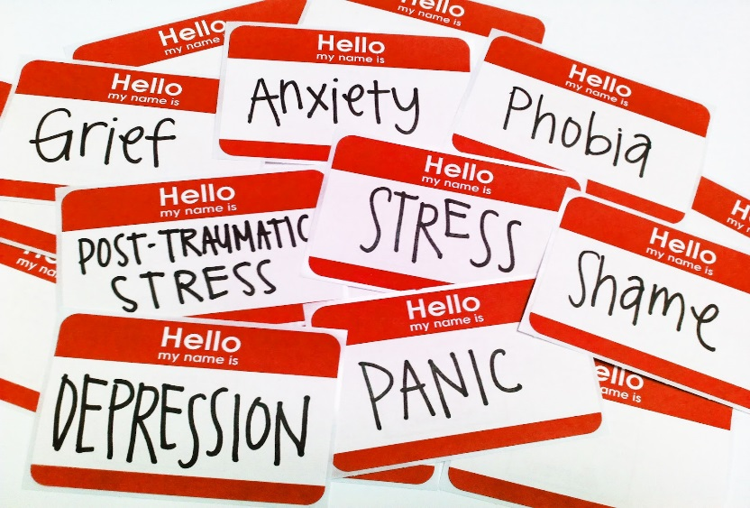
Types of Wellbeing/ Common Mental Health issues supported?
Compulsive behaviours
Depression/ Low Mood
Disordered Eating
Anxiety and Panic
Stress
Sleep problems
Self-harm

Slide 13
Mental Health Advisors
Who are they there for?
Students with an existing moderate to severe and enduring mental health diagnosis
Students experiencing possible emerging mental health conditions
Students in crisis or in need of urgent/ emergency mental health support

Slide 14
What do they provide?
121 support
Crisis and Emergency response
Liaison between student and Statutory or 3rd Sector Services
Tiered support including monitoring, Mental Health Support Plan and Crisis Support Plan
Advocacy between student and UoL and vice versa
Referrals into external psychiatric services

Slide 15
Mental Health conditions supported?
Schizophrenia
Paranoid Schizophrenia
Eating disorders
Psychosis/ Psychotic Disorders
Dual Diagnosis
Bi-polar Affective Disorder
Co-morbid mental health conditions
Borderline Personality Disorder

Slide 16
How do students access support?
Online self-referral form:
https://leeds.onlinesurveys.ac.uk/student-counselling-wellbeing-service-self-referral-form-5
http://students.leeds.ac.uk/counsellingandwellbeing

Slide 18
Appointments are offered in two locations:
Counselling appointments and workshops are usually held at 19-21 Clarendon Place, LS2 9JY
Mental Health and Wellbeing Support appointments are usually held adjacent to Disability Services in Chemistry West Block, LS2 9JT

Slide 19
Five Ways to Wellbeing
NEF were commissioned to develop the Five Ways to Well-being to communicate key findings.
Connect
Be active
Take notice (mindfulness)
Keep learning
Give
http://www.neweconomics.org/projects/entry/five-ways-to-well-being
Notes:
The key recommendations generated from the report identified a simple “five-a-day” programme of social and personal tasks that can promote mental wellbeing as well as physical fitness that individuals should be encouraged to build into their daily lives.

Slide 20
Thank you for listening
Email scc@leeds.ac.uk or phone 0113 343 4107

