Slide 1
School of Earth and Environment Faculty of Environment
Welcome!
Induction Meeting
Postgraduate Research (PGR) Degree Study:
PhD
MPhil
MSc by Research
October 2018

Slide 2
School of Earth and Environment Faculty of Environment
Today:
9.15 Welcome: Professor Simon Bottrell, Head of School
9.20 Studying for your research degree: Dr Ian Burke, Director of Postgraduate Research
10.15 Drinks break (foyer)
10.45 Finance and Purchasing: Georgina Given and Robert Lavery
11.05 Sustainability Service – Strategy/Opportunities/Information
11.10 Health & Safety: Sarah Burdall
11.25 Interactive session with PGR Representatives
11.45 Group Photo: Mark Bickerdike (from foyer)
12.15 Departmental Tour: Bob Finch and Ben Clarke (from foyer)
12.45 Lunch provided (foyer)
13.00-14.00 Room allocation, photos, keys/fobs (SR 1)
14.00-16.00 SRI (only) Institute Welcome (SR 3): Dr Milena Buchs and Dr Alice Temple
From 3.30pm Welcome Party
hosted by your PGR Representatives!

Slide 3
School of Earth and Environment Faculty of Environment
Key facts
About our School
Ranked 1st in the UK for the quantity of its world leading research (REF2014)
Ranked 2nd in the UK for the quality of its research environment (REF2014)
90% of our research has reached world leading and internationally excellent standards based on overall quality (REF2014)
One of the largest research clusters of environmental and social scientists in the UK and internationally
Over 100 research active members of staff
Over 250 postgraduate researchers (PGRs)
Over 150 taught postgraduate Master’s (PGT)

Slide 4
School of Earth and Environment Faculty of Environment
Our mission
to combine world-class earth and environment sciences with environmental social sciences in both fundamental and applied research
REF2014

Slide 5
School of Earth and Environment Faculty of Environment
Coping in a challenging research environment…
Build resilience (confidence, purposefulness, adaptability, social support)
Set goals/targets and keep on track
Build good relationships with supervisors and informal networks
Ask or seek help as and when needed
Write regularly
Read extensively
Be adaptable
Maintain positive outlets for good well-being (creative, sports, nature, social) and take care of yourself (nutrition)

Slide 6
School of Earth and Environment Faculty of Environment
Training and Careers…
in-training as independent early-career researcher
take control and responsibility for training and development
take every opportunity to experience presenting your work
get involved in teaching on taught programmes
speak with supervisors from very start about your career aspirations
network extensively and explore/investigate career options from outset
make use of excellent resources available to you: training provision available within university (research group, OD&PL) and external (collaborators, placements); careers service; supervisor networks and collaborative partners (internships)

Slide 7
School of Earth and Environment Faculty of Environment
Leeds Doctoral College
Faculty of Environment
Faculty of Biological Sciences (FBS)
SEE
GEOG
Leeds University Business School (LUBS)
Faculty of Engineering
ITS
Faculty of Mathematics and Physical Sciences (MaPS)
Faculty of Economics Social Sciences and Law (ESSL)
Faculty of Arts, Humanities and Cultures (AHC)
Faculty of Medicine and Health

Slide 8
School of Earth and Environment Faculty of Environment
SRI
Economics and Policy for Sustainability; Environment and Development; Social and Political Dimensions of Sustainability; Business and Organisations for Sustainable Societies; Energy and Climate Change Mitigation
SEE
ESSI
Palaeo@leeds
Cohen Geochemistry
Leeds University Business School (LUBS)
Faculty of Engineering
ICAS
Climate and Climate Impacts; Atmosphere and Cloud Dynamics; Atmospheric Chemistry and Aerosols
Sciences (MaPS)
Faculty of Economics Social Sciences and Law (ESSL)
IGT
Deep Earth; Geodynamics and Tectonics; High Temperature Geochemisry; Volcanology
IAG
Applied Geophysics; Basin Structure Group; Rock Mechanics/Engineering Geology, Geomechanics; Minerals and Ore Geology; Sedimetology
Faculty of Arts, Humanities and Cultures

Slide 9
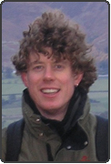
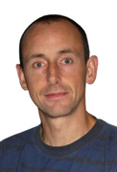
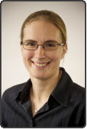
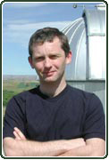
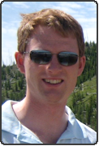
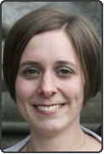
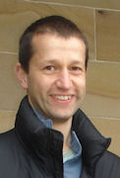
School of Earth and Environment Faculty of Environment
The Research Institute
Directors
ESSI (Earth Surface Science)
Dr Rob Newton
IAG (Applied Geoscience)
Professor Nigel Mountney
Dr Rachael Spraggs
ICAS (Climate and Atmospheric Science
Professor Martyn Chipperfield
IGT (Geophysics and Tectonics)
Dr Phil Livermore
SRI (Sustainability)
Dr Lucie Middlemiss
Dr Martin Dallimer

Slide 10
School of Earth and Environment Faculty of Environment
ESSI (Earth Surface Science)
Dr Rob Newton
Presenting – talks, posters
Research Culture
Research Group Meetings
Seminar Series
Internships
Collaborating
Training
Social

Slide 11
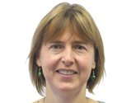
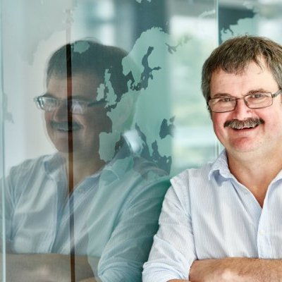
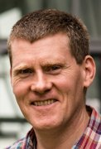
School of Earth and Environment Faculty of Environment
Key people
Professor Pippa Chapman
Head of Graduate School
Professor
Simon Bottrell
Head of School
Dr Jared West
Deputy Head
Dr Jim McQuaid
Deputy Head

Slide 12
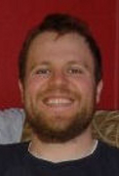
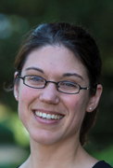
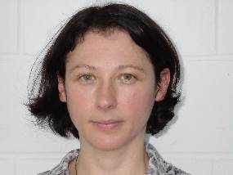
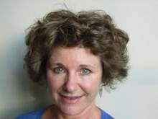
School of Earth and Environment
FACULTY OF ENVIRONMENT
PGR Support
Drop-ins every Wednesday:
Ian Burke: 9-10am
Phil Livermore: 11-12noon
Fiona Gill: maternity leave until Feb 2019
No appointment needed.
Just go along to the office during the allocated time.
PGRs can meet the PGRD or Deputies at any
other time by making an appointment.
Milena Buchs: please arrange meeting
by email directly
Michelle Lesnianski: call by the Environment Graduate School Office at any time
Dr Ian Burke
Director of Postgraduate Research Studies
Room 9.150 (South Wing)
i.t.burke@leeds.ac.uk
Dr Milena Buchs
Deputy Director (SRI)
Room 11.114 (North Wing)
M.M.Buchs@leeds.ac.uk
Dr Fiona Gill
Deputy Director (well-being)
Room 10.17e (South Wing)
f.gill@leeds.ac.uk
Dr Phil Livermore
Deputy Director (modelling/computing)
Room 8.137 (South Wing)
p.w.livermore@leeds.ac.uk
Michelle Lesnianski
Environment Graduate School
Room 9.27 (Priestley)
apply-phd@leeds.ac.uk

Slide 13
School of Earth and Environment Faculty of Environment
…management structure
Leeds Doctoral Collage University Graduate Board
Faculty of Environment Graduate School Committee
School Research Committee
Head of School
Director of Postgraduate Research and Deputies
Postgraduate Researcher (You!) …. Supervisors

Slide 14
School of Earth and Environment Faculty of Environment
…management structure
University Graduate Board
Faculty of Environment Graduate School Committee
School Research Committee
Head of School
Postgraduate Research Tutor
Research Degree Student (You!) …. Supervisor/RSG
Postgraduate Researcher (You!) …. Supervisors
Director of Postgraduate Research and Deputies
Head of School
School Research Committee
Faculty of Environment Graduate School Committee
Leeds Doctoral College University Graduate Board

Slide 15
School of Earth and Environment Faculty of Environment
…our aim
PhD researchers:
To advise on your development to be capable of independent research and examiners must comment on:
Evidence of originality
Evidence of independent critical ability
Undertaking research suitable for publication
To aid in your development as an employable graduate
Technical competence alone is insufficient to merit the award of PhD; you must have significantly advanced knowledge in your field and demonstrated a broad understanding of the scientific and societal context of your research.

Slide 16
School of Earth and Environment Faculty of Environment
…our aim
To advise on your development to be capable of independent research and examiners must comment on:
MPhil researchers:
the quality of the research undertaken; and
the independent contribution to knowledge and scholarship
MSc by Research researchers:
the quality of the research undertaken; and
the extent to which the thesis interprets and communicates knowledge in the chosen research area
To aid in your development as an employable graduate

Slide 17
School of Earth and Environment Faculty of Environment
An illustrated guide to a PhD
Matt Knight
University of Utah
http://matt.might.net/articles/phd-school-in-pictures/

Slide 18
School of Earth and Environment Faculty of Environment
Imagine a circle that contains all of human knowledge:

Slide 19
School of Earth and Environment Faculty of Environment
By the time you finish elementary school, you know a little:

Slide 20
School of Earth and Environment Faculty of Environment
By the time you finish high school, you know a bit more:

Slide 21
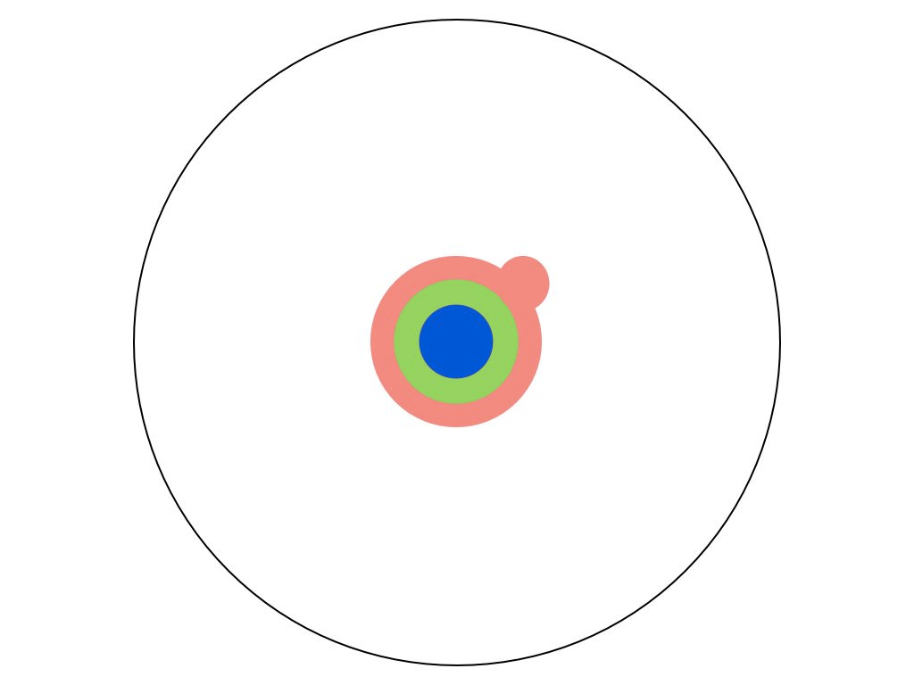
School of Earth and Environment Faculty of Environment
With a bachelor's degree, you gain a specialty:

Slide 22
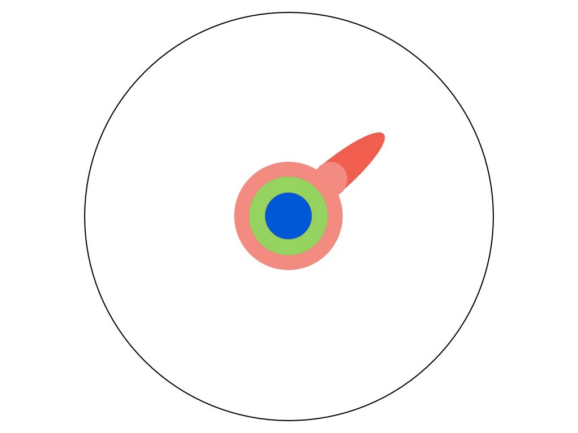
School of Earth and Environment Faculty of Environment
A master's degree deepens that specialty:

Slide 23
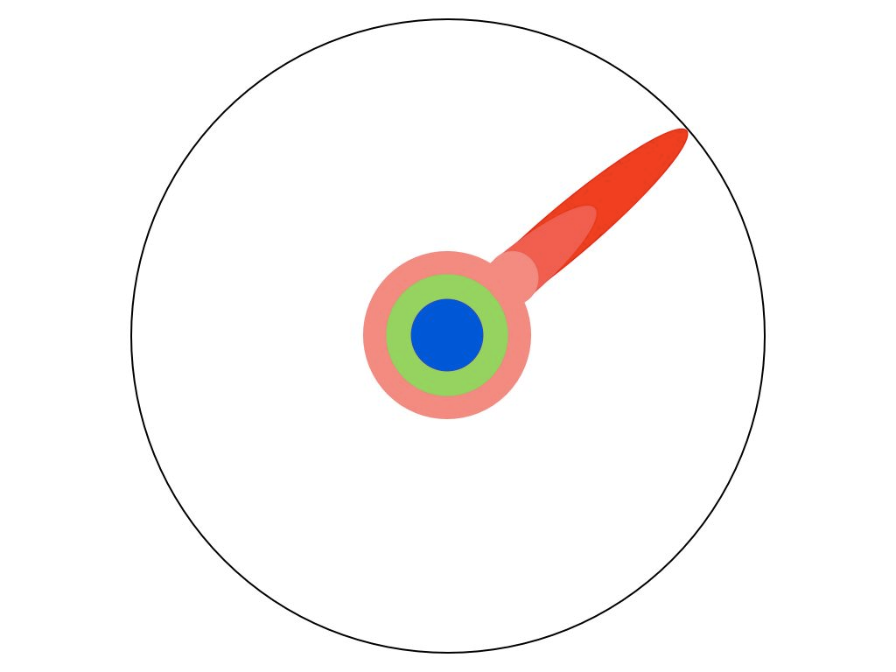
School of Earth and Environment Faculty of Environment
Reading research papers takes you to the edge of human knowledge:

Slide 24
School of Earth and Environment Faculty of Environment
Once you're at the boundary, you focus:

Slide 25
School of Earth and Environment Faculty of Environment
You push at the boundary for a few years:

Slide 26
School of Earth and Environment Faculty of Environment
Until one day, the boundary gives way:

Slide 27
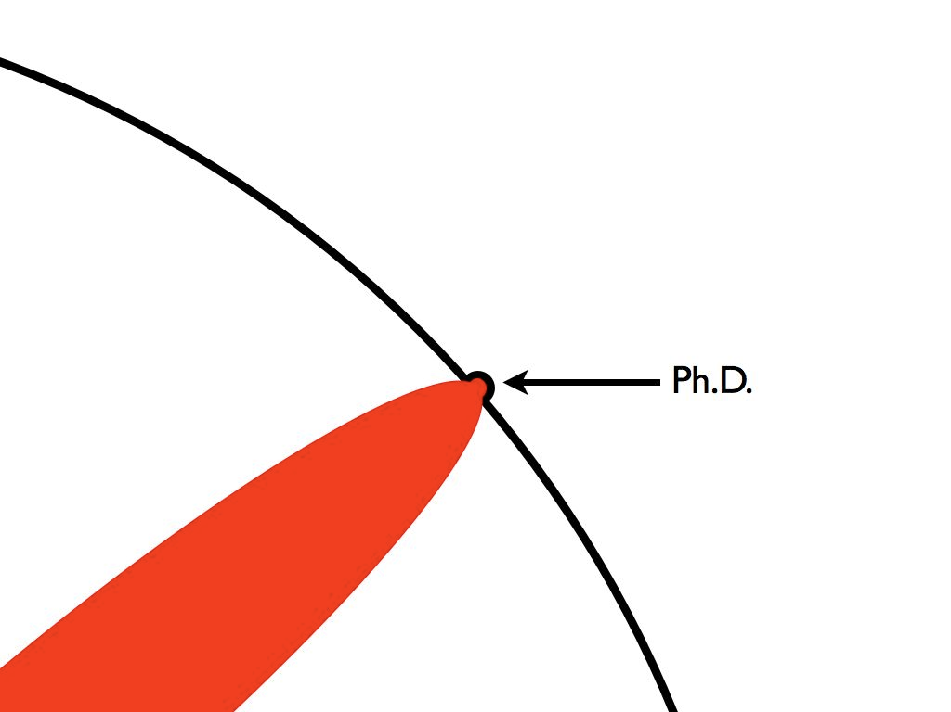
School of Earth and Environment Faculty of Environment
And, that dent you've made is called a Ph.D.:

Slide 28
School of Earth and Environment Faculty of Environment
Of course, the world looks different to you now:

Slide 29
School of Earth and Environment Faculty of Environment
So, don't forget the bigger picture:

Slide 30
School of Earth and Environment Faculty of Environment
So, don't forget the bigger picture:
Keep pushing

Slide 31
School of Earth and Environment Faculty of Environment
…aims of research degree study
Advancement of knowledge
Acquisition of key research skills
Award is a recognition of such a level of professional competence and innovative skills that you can be expected to undertake effective research without the need for supervision

Slide 32
School of Earth and Environment Faculty of Environment
…at the end of your research you should have:
Completed work that is innovative and, in the case of a PhD, work which has made a significant advancement in knowledge in your field
Presented a concise high quality thesis of no more than:
PhD - 100,000 words (300 pages)
MPhil - 60,000 words (200 pages)
MSc by Research - 30,000 words (100 pages)
A sound knowledge of the literature and data sources in your subject
A good understanding of the concepts underpinning your research field
Competence in the techniques used in the study and understanding of the principles of methods utilized in the instrumentation and in any limitations to the equipment used

Slide 33
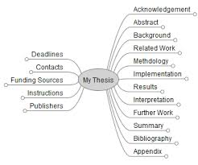
School of Earth and Environment Faculty of Environment
Format of PhD thesis
PhD researchers (only) have the option of submitting:
Standard thesis; or
Alternative format thesis
Note that each format is academically equal to the other.
Standard thesis:
Normally between 6-9 chapters including introduction, methodology, discussion, results chapters, conclusions and future work, references.
Alternative format thesis:
Minimum of 5 chapters including introduction, 3 journal publications (see below), conclusions and future work. Each chapter will have its own references.
Minimum requirements: one journal publication accepted; an invitation to resubmit a paper with revisions; and a third journal publication in a format close to submission.
More journal publications can be included but must keep within maximum 300 pages overall length (100,000 words) AND research must tell a story and not be disjointed.
PGRs and Supervisors should discuss at the outset the possibility of this option.

Slide 34
School of Earth and Environment Faculty of Environment
Format of PhD thesis
Alternative format thesis:
Operating in Environment since November 2015
Faculties offering this option are: Environment, Engineering, Biological Sciences, and Dentistry
Not appropriate in every subject area – speak with supervisor
31 PhDs using this format examined in this School since 2015
That is 30% of total PhDs awarded since November 2015
20% awarded with ‘Research Excellence’

Slide 35
School of Earth and Environment Faculty of Environment
…your supervision/examination team
You will have a Primary Supervisor who will take primary responsibility for your research degree supervision
You will have a co-supervisor
You may have an external supervisor (CASE awards, collaborations)
You will have a Transfer Examiner (PhD upgrades only)
You will have a Transfer Chair (PhD upgrades only)
You will have an Internal Examiner and an External Examiner for your final viva (part-time researchers who are also members of staff will have an Internal and two External Examiners)
You may have an Independent Chair for your final viva

Slide 36
School of Earth and Environment Faculty of Environment
…at least once during your research degree
attend an international conference
attend the University’s Showcase Postgraduate Researcher Conference (December each year)
attend a UK Grad School ‘vitae’ if you are sponsored by a UK research council

Slide 37
School of Earth and Environment Faculty of Environment
Mandatory Online Tutorials: GRAD
Welcome to GRAD
https://mymedia.leeds.ac.uk/Mediasite/Play/3e62f90bf67045548b100b3fede0cb1b1d
Transfer process
https://mymedia.leeds.ac.uk/Mediasite/Play/d22cf3e27faf4912a31f14efeb4cb45c1d
Sharing notes before a meeting
https://mymedia.leeds.ac.uk/Mediasite/Play/e9b67886a17d4a42b1e480ecc97733e01d
Sharing notes after a meeting
https://mymedia.leeds.ac.uk/Mediasite/Play/1bce389c46d446ec9a2a40bc0dda7efe1d
Progress report
https://mymedia.leeds.ac.uk/Mediasite/Play/8b72910ca91a4e6fa52f75ab8d112fb11d

Slide 38
School of Earth and Environment Faculty of Environment
Mandatory Online Tutorials:
Leeds Doctoral College
Pre- and post-Transfer and support
https://minerva.leeds.ac.uk/webapps/blackboard/content/listContentEditable.jsp?content_id=_6050680_1&course_id=_474527_1
(logon is ISS Username@leeds.ac.uk and email password)

Slide 39
School of Earth and Environment Faculty of Environment
English Language…
The University operates a traffic light system for PGRs for whom English is not their first language:
GREEN: No core language problems identified.
AMBER: Further core language development likely beneficial
RED: Language puts PGR at risk of not achieving Transfer
All incoming PGRs are designated as AMBER.
Supervisors and PGR discuss together to assess whether further support needed.
PGR programme and enrolment procedures at:
https://www.leeds.ac.uk/arts/info/125008/English_language/2392/insessional_classes/3

Slide 40
School of Earth and Environment Faculty of Environment
The most exciting phrase to hear in science, the one that heralds new discoveries, is not 'Eureka!' but
'That's funny...'
Isaac Asimov

