Slide 1
Introduction to Purchasing Richard Lewis
July 2018

Slide 2
Presentation Key Theme:
Purchasing Structure
University Financial Rules
Purchasing Systems
Notes:
Public Money, Grants – AUDIT - Transparency

Slide 3
Operations Team Responsibilities:
Day to day procurement
Advice & Guidance
New Vendor setup
Blocked & Parked Invoices
Systems Training
Systems Maintenance
Sustainability projects
Category/Contracts Management:
Policies/Procedures & Strategy
Tenders & High Value Procurements – (Services & Equipment)
Category/contract Management

Slide 4
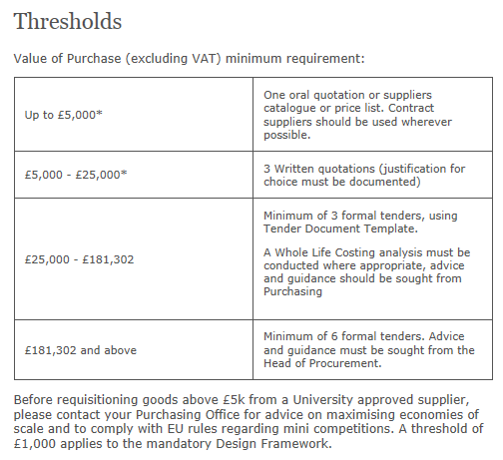

Slide 5
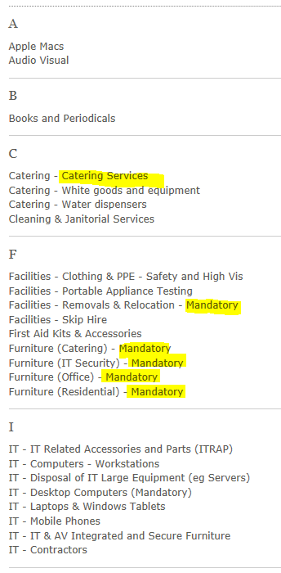
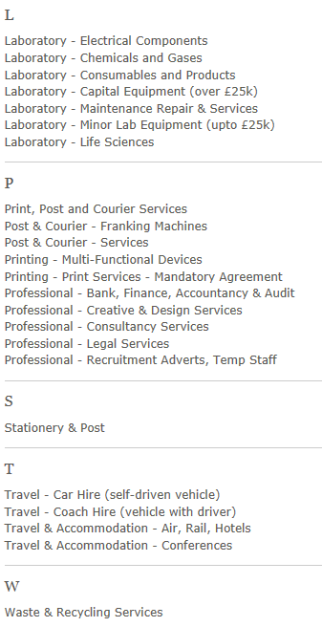
Contracted Suppliers:

Slide 6
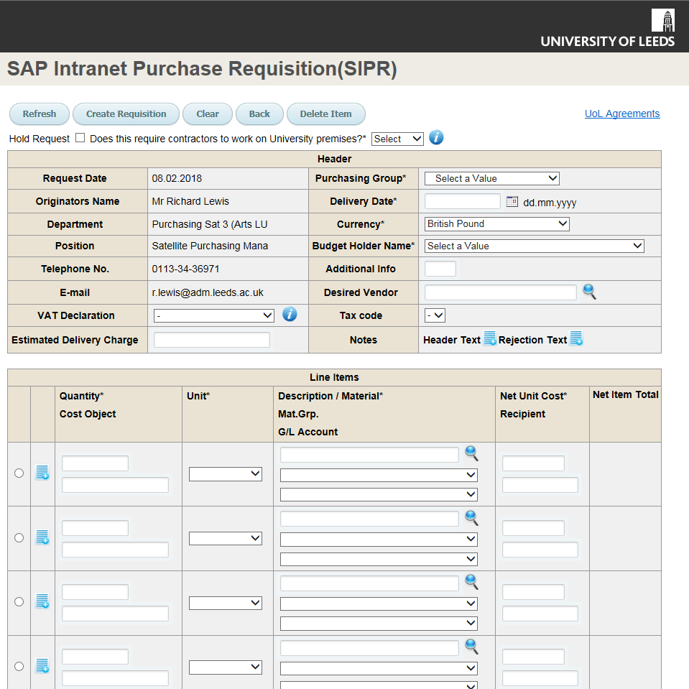
SAP SE (Systeme, Anwendungen und Produkte in der Datenverarbeitung; "Systems, Applications & Products in Data Processing") is a German multinational software corporation that makes enterprise software to manage business operations and customer relations. SAP is headquartered in Walldorf, Baden-Württemberg, with regional offices in 130 countries. The company has over 335,000 customers in over 180 countries.
SIPR – Requisitioning System
Science Warehouse
Purchase Cards

Slide 7
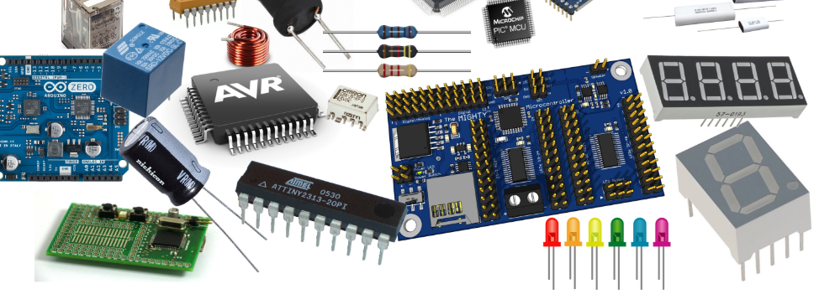

Slide 8
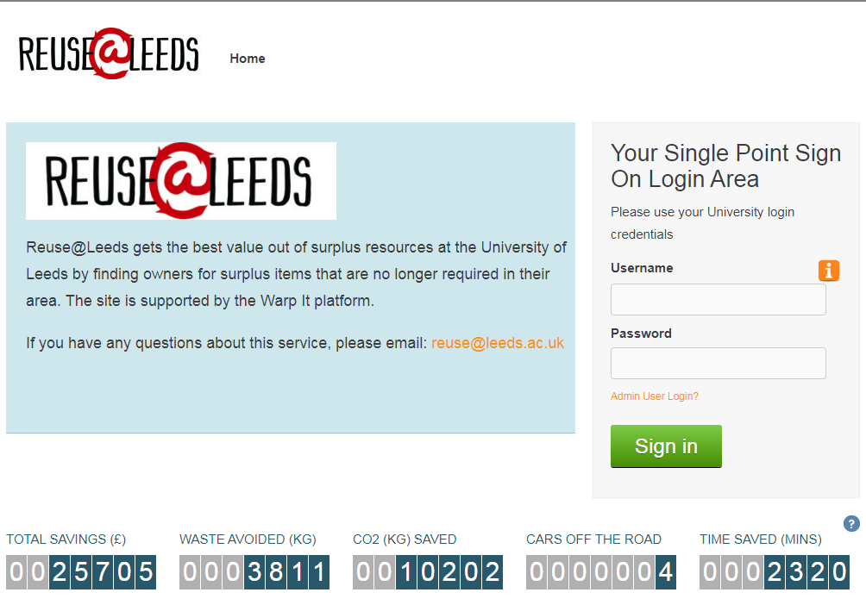
https://www.warp-it.co.uk/company/uol

Slide 9
The Purchasing Cycle
Faculty/School
Operational Purchasing
Faculty/
School
Accounts Payable
Business Requirement to Purchase
Purchase Requisition
Budget Holder Approval
FA
Approval
Release Purchase Order
Delivery Receipt (GR)
Purchase Invoice verification
Purchase Invoice Payment
SIPR
Science Warehouse
SAP
Purchase Card
SAP
SAP
Notes:
In an ideal world this is an complete process but if any stages are broken the invoice will fail. Any guesses for the most common reason?

Slide 10
SAP Goods Receipt & Blocked
Invoices
Impact of Late Payment!
Both Purchasing and Finance waste time chasing requisitioners or Goods Receipters to try and clear the issues.
Suppliers put our accounts on STOP and in doing so prevent other Faculties from receiving their Goods/Services
Suppliers lose interest in supplying the University and the reputation of the University is damaged.
Legal Requirement – ‘Late Payment Act’
Notes:
Accounts on Stop, Interest Charges, Reputation, Annual Stats in Accounts …

Slide 11
Audit Issues:
Low Value Orders – Cost of Purchasing ‘£’
Retrospective Orders
Detail in SIPR Requisition
Incorrect Order/invoice Setup
Employment Status (IR35) – Contractors/Consultants
New Vendors - Foreign Vendors

Slide 12
Sustainability

